Slide 1
Midterm Project
- -Proposal Presentation
NYU Tandon IDM Web Development Spring 2026
FEB 24 2026
Presented by
Ding. Andy
NYU TANDON IDM WEBDEV_SPRING 26
FEBRUARY
2026

Slide 2
Content
1
Concept / Theme of the Site
2
Inspiration Website (Pinterest)
3
Concept / Skill - -COVERED
4
Concept / Skill - -STILL LEARN
5
Wireframe & Sitemap
NYU TANDON IDM WEBDEV_SPRING 26
FEBRUARY
2026

Slide 3

PART 1:
Concept / Theme of the Site
Midterm Project - - Proposal Presentation
NYU TANDON IDM WEBDEV_SPRING 26
February
2026

Slide 4
Concept / Theme
Of the Site
Theme:
A minimalist and elegant digital portfolio showcasing my calligraphy practice, philosophy, tools, and selected works.
Clean, simple, white-and-black layout inspired by the aesthetics of rice paper, ink, and brush strokes. The site should feel calm, artistic, and meditative—like stepping into a calligraphy studio.
Visual Concept:
NYU TANDON IDM WEBDEV_SPRING 26
February
2026

Slide 5
Concept / Theme
Of the Site
@ My calligraphy journey
@ A gallery of brush, ink, and experimental works
@ The meaning and inspiration behind each piece
@ A short artist bio
@ A section explaining techniques and tools
@ A contact form for collaborations
The Website will Present:
NYU TANDON IDM WEBDEV_SPRING 26
February
2026

Slide 6
PART 2:
Inspiration Website (Pinterest)
Midterm Project - - Proposal Presentation
NYU TANDON IDM WEBDEV_SPRING 26
February
2026

Slide 7
Inspiration
Website
Studio Chavelli
Calligraphy & Design Website
https://chavelli.com/portfolio
This is the official website of a professional calligrapher and lettering designer. The layout is clean and elegant, combining text and imagery in a balanced way. The site highlights the artist’s personal style, service offerings, and selected works with strong visual storytelling.
NYU TANDON IDM WEBDEV_SPRING 26
February
2026

Slide 8
Inspiration
Website
Studio Chavelli
Calligraphy & Design Website
https://chavelli.com/portfolio
Key Features
# Integrated typography and imagery
# Clear display of calligraphy and design projects
# Strong sense of artistic identity and branding
NYU TANDON IDM WEBDEV_SPRING 26
February
2026

Slide 9
Inspiration
Website
Pinterest Collection
https://pin.it/iOb6BKTCj
NYU TANDON IDM WEBDEV_SPRING 26
February
2026

Slide 10
PART 3:
Concept / Skill (COVERED)
Midterm Project - - Proposal Presentation
NYU TANDON IDM WEBDEV_SPRING 26
February
2026

Slide 11
Concept / Skill (COVERED)
​​​​​​HTML Structure & Content
Using core tags such as
<html>, <head>, <body>, <h1>–<h6>, <p>, <a>, <img>, <ul>, <ol>, <li>.
Nesting elements properly and maintaining clean indentation..
Creating headings to establish content hierarchy, inserting paragraphs, and adding links to internal and external pages.
Embedding images using the src attribute and working with self-closing tags like <img />.
NYU TANDON IDM WEBDEV_SPRING 26
February
2026

Slide 12
Concept / Skill (COVERED)
​​​​​​Basic CSS Styling
Applying CSS to control layout and visual appearance.
Understanding the separation of HTML=content, CSS=style.
​​​​​​Basic Forms
Creating simple forms using <form>, <label>, <input> and attributes such as action, method, type, placeholder, and maxlength.
​​​​​​Information Architecture
Building a sitemap to define site navigation.
Understanding how to logically group and categorize content.
NYU TANDON IDM WEBDEV_SPRING 26
February
2026

Slide 13
PART 4:
Concept / Skill (STILL LEARN)
Midterm Project - - Proposal Presentation
NYU TANDON IDM WEBDEV_SPRING 26
February
2026

Slide 14
Concept / Skill (STILL LEARN)
More Advanced CSS
Layout techniques such as flexbox, grid, and responsive design.
Creating a consistent design system:
colors, fonts, margins, paddings, and typography.
Styling navigation menus and creating visually appealing galleries.
Website Deployment
Learn how to publish the website online
NYU TANDON IDM WEBDEV_SPRING 26
February
2026

Slide 15
PART 5:
Wireframe & Sitemap
Midterm Project - - Proposal Presentation
NYU TANDON IDM WEBDEV_SPRING 26
February
2026

Slide 16
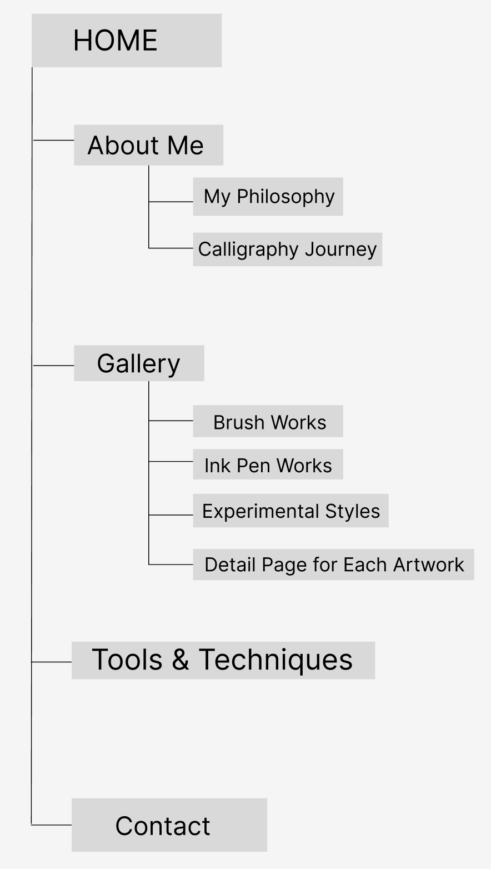
Wireframe
NYU TANDON IDM WEBDEV_SPRING 26
February
2026

Slide 17
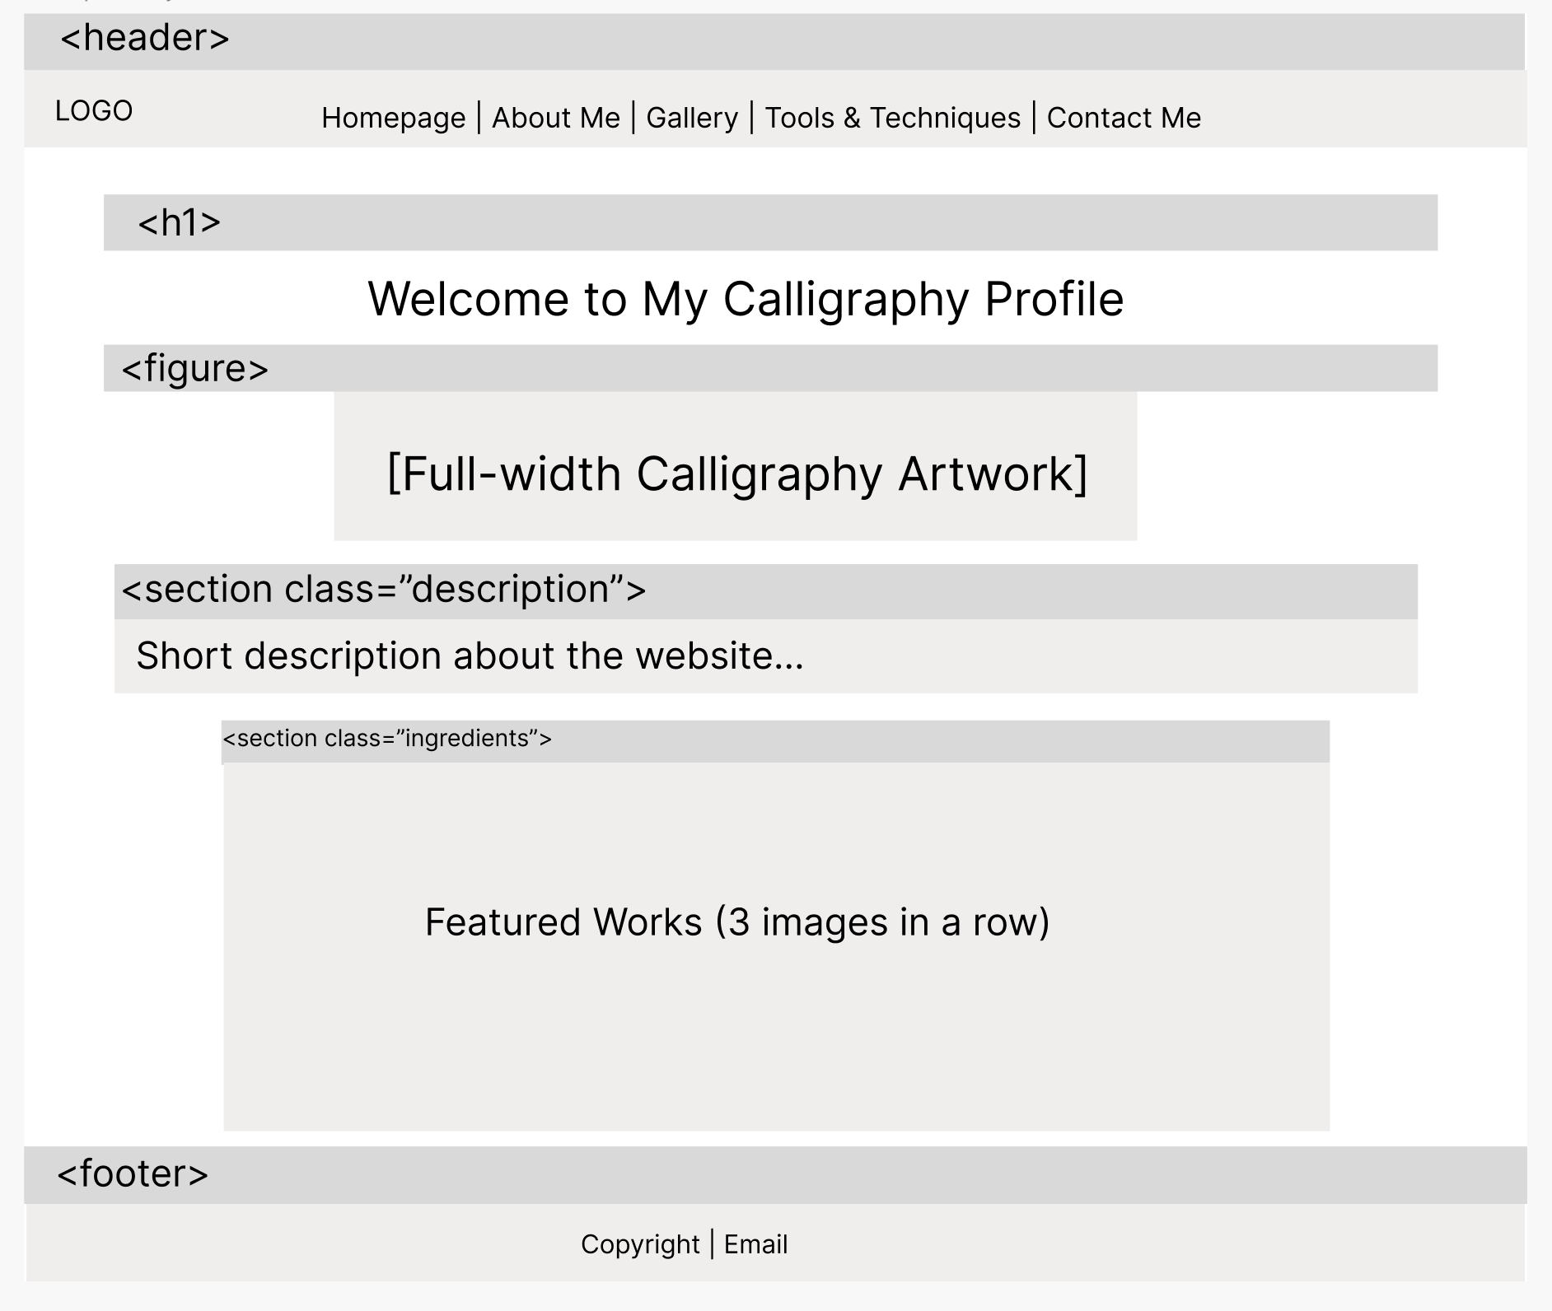
Sitemap
NYU TANDON IDM WEBDEV_SPRING 26
February
2026

Slide 18
Midterm Project
- -Proposal Presentation
NYU Tandon IDM Web Development Spring 2026
FEB 19 2026
Presented by
Ding. Andy
NYU TANDON IDM WEBDEV_SPRING 26
FEBRUARY
2026

